Slide 1
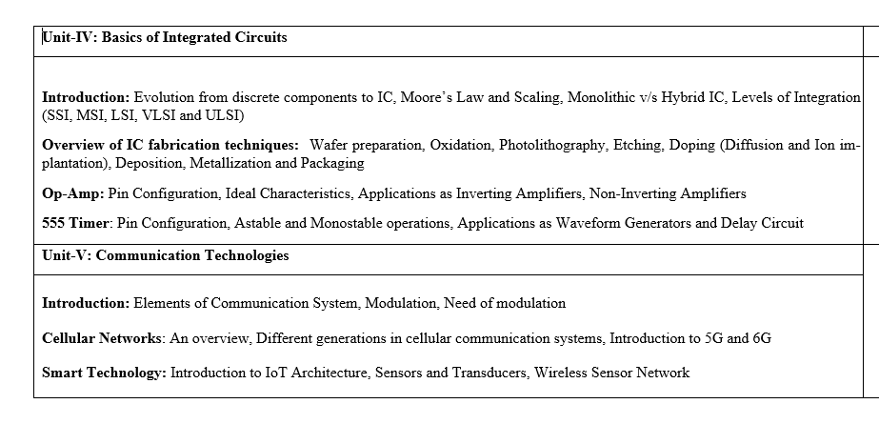

Slide 2
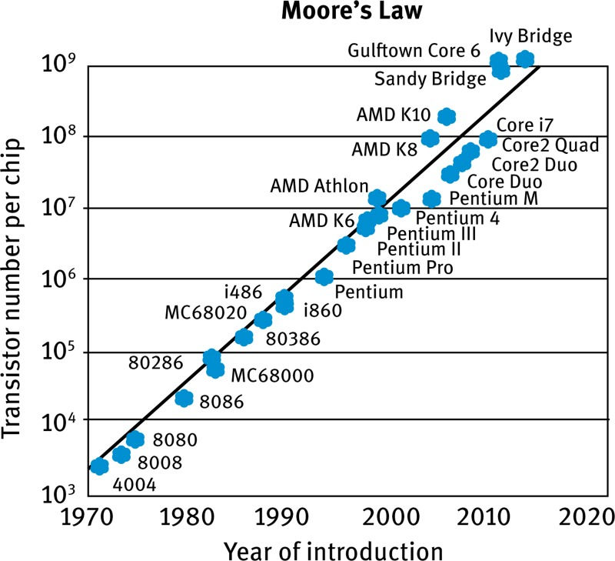

Slide 3
Gordon Moore one of the co-founders of Intel corporation established the term "Moore's Law" in 1965, This law explains how the number of transistors on integrated circuits is increasing exponentially, which boosts computing capability and lowers prices.
Moore's Law Definition
The exponential increase in the number of transistors on integrated circuits over time is referred to as Moore's law. According to this, a chip transistor count tends to double every two years or so, resulting in higher processing power and better performance.
Transistor Scaling
Transistor scaling, a crucial component of Moore's law, has proved essential in advancing technology in many different fields. Transistors act as switches that regulate the flow of electrical current within microchips, serving as the essential building blocks of electronic devices. As technology developed engineers concentrated on shrinking and packing transistors more closely together on a chip.
Pentium processor in 1993 had 3.1 million transistors, in 1995 the subsequent version of Pentium processor had 5.5 million transistors, and by 2003 the number had greatly expanded to 55 million this showcases the steady growth predicted by Moore's law.

Slide 4
The ongoing advancement of Moore's law is hampered by a number of physical constraints as transistor size decreases.
The quantum effects at such small scales are one of these restrictions. When electrons leak past barriers as a result of quantum tunneling for example, transistor actions become inaccurate and unstable.
As transistors get smaller this tendency gets stronger, making it more challenging to maintain steady, predictable behavior.
Dissipation of heat presents another issue.
Temperature inside the chip are raised as a result of increased heat generation as transistors are stacked closer together.
Heat dissipation becomes a serious issue since it can impact dependability, reduce performance, and increase energy consumption.

Slide 5
Monolithic circuits are acts as full circuits designed on a single piece of silicon or any semiconductor. Examples: Operational amplifier IC741.
Hybrid technology: Hybrid technology has a ceramic substrate that carries many silicon chips. It can also use mixed technology like GaAs chips along with silicon chips.
Feature | Monolithic IC | Hybrid IC
Construction | All components are fabricated on a single chip. | Multiple components are assembled on a substrate.
Components | Transistors, diodes, resistors, and capacitors are all made on the same chip. | Mix of discrete components (resistors, capacitors, inductors) and/or separate monolithic ICs.
Size | Compact and smaller. | Can be larger, depending on the number of components.
Flexibility & Customization | Limited customization options. | High flexibility and customization.
Repair/Modification | Difficult to repair or modify. | Easier to repair and modify due to modular nature.
Cost | Generally lower for mass-produced units. | Cost varies; can be higher due to complexity, but also cheaper for certain specialized applications.
Speed | High speed. | Generally lower speed compared to monolithic ICs.
Complexity | Simpler in terms of a single chip's integration. | More complex due to the integration of different technologies and components.

Slide 6
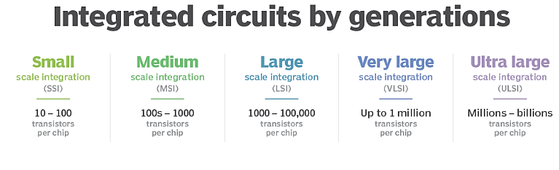
Key characteristics of each level
SSI: Early integrated circuits with the lowest density. They were crucial for early aerospace projects and performed simple functions.
MSI: Contains more complex circuits, such as decoders, adders, multiplexers, and counters.
LSI: Incorporated thousands of transistors, leading to more complex devices like calculators and processors.
VLSI: A major advancement that enabled the creation of microprocessors and complex computer chips with millions of components.
ULSI: The most advanced level, integrating billions of transistors and used in high-performance processors like the Pentium.

Slide 7
Applications and significance
SSI: Used for very basic logic circuits.
MSI: Enabled more complex logic circuits and was suitable for applications like counters, adders, and decoders.
LSI: Revolutionized technology and made devices like the first microprocessors possible.
VLSI: Enabled the growth of modern computing by fitting billions of transistors onto a single chip, leading to modern CPUs and memory chips.
ULSI: Supports modern computers by integrating even larger numbers of components, essentially extending the capabilities of VLSI.
The progression from SSI to ULSI has significantly reduced the size and cost of components while increasing their power and efficiency, a trend that continues to drive modern electronics.

Slide 8
Integrated Circuits Fabrication Process
Silicon Wafer Preparation
Oxidation
Photolithography
Etching
Metallization
Packaging
Doping (Diffusion & Ion implantation)
Deposition

Slide 9
The major processes used repeatedly in IC fabrication include:
Wafer Preparation: Starts with a highly pure, single-crystal silicon ingot that is cut into thin wafers, then ground and polished to a mirror-like finish. This initial stage creates the foundation for the entire IC. Crystal Growth: Highly purified silicon is melted, and a seed crystal is slowly pulled from the melt, forming a large, single-crystal cylinder called an Ingot. Slicing: The ingot is precisely sliced into thin, circular wafers (typically 300 mm in diameter today). Polishing and Cleaning: The wafers are ground and polished to a near-atomic flatness and subjected to rigorous chemical cleaning to remove all surface contaminants.
Oxidation: Growing a thin layer of silicon dioxide on the silicon surface, typically in a high-temperature furnace. This layer acts as an insulator (e.g., the gate oxide in a MOSFET) or as a mask during doping.
Photolithography : The process of transferring a circuit pattern from a photomask onto the wafer surface. A light-sensitive material called photoresist is coated onto the wafer, exposed to UV light through the mask, and then developed to selectively remove parts of the photoresist, leaving a pattern.
Etching: Selectively removing unmasked layers of material polysilicon) using wet chemicals or, more commonly, dry plasma etching. This transfers the photoresist pattern onto the wafer material.
Doping (Diffusion / Ion Implantation): Introducing impurity atoms (dopants like Boron for p-type or Phosphorus/Arsenic for n-type) into the silicon to change its electrical conductivity. Ion Implantation is the most common modern method, where ions are accelerated and precisely embedded into the silicon substrate.
Metallization: Depositing and patterning layers of metal (e.g., copper or aluminum) to create the interconnections (wires) that link the various components (like MOSFETs) together.
Isolation/Deposition: Adding thin films of material (semiconductors, insulators, or metals) onto the wafer surface, often via Chemical Vapor Deposition (CVD) or Physical Vapor Deposition (PVD). These steps are also crucial. Isolation uses techniques to separate individual components, while deposition adds layers of different materials.
Testing and packaging: Once all layers are complete, the wafer is cut into individual chips (dies). Each chip is tested, and then placed into a protective housing called a package, which also provides the external electrical connections.

Slide 10
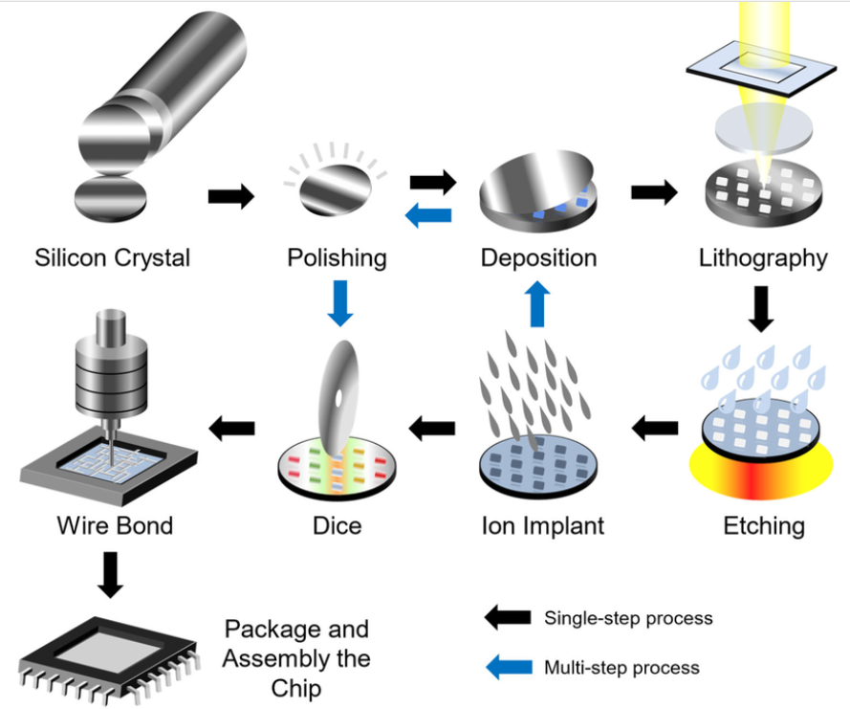
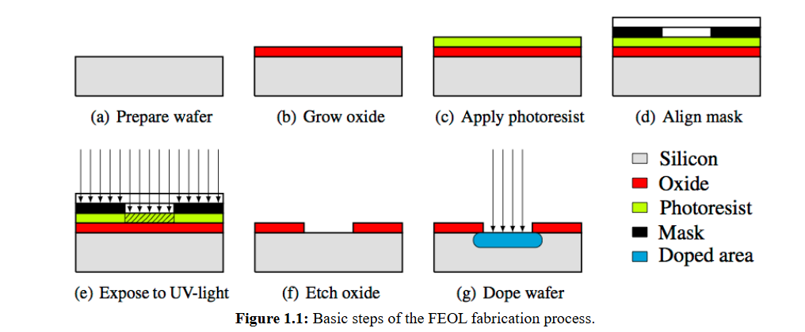
Integrated Circuits Fabrication Process

Slide 11
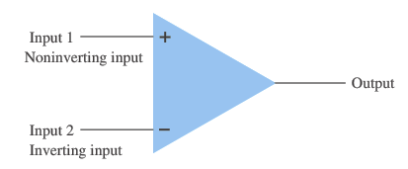
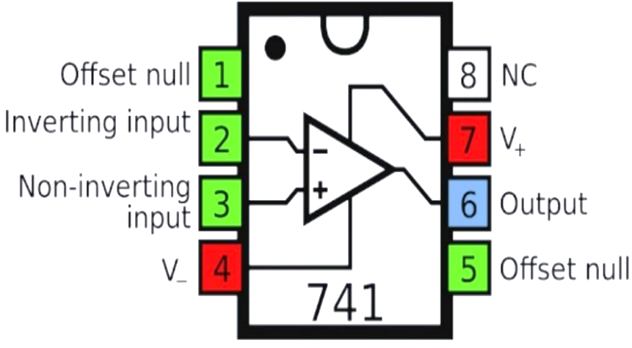
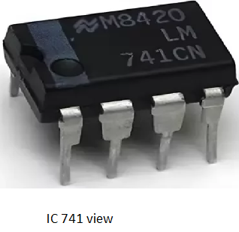
OPERATIONAL AMPLIFIER (OP-AMP.)
3.1 Introduction
Operational Amplifier (Op-amp) is a very high voltage gain, DC coupled Differential amplifier.
It is basically an integrated circuit (IC).
Op-amp can amplify a weak signal as well as it can implement various mathematical operations like addition, subtraction, comparisons, log/antilog values, integration, differentiation etc, so that known as Operational Amplifier.
The Basic building block of Op-amp is a “Differential amplifier”.
Op-amp symbol
741 PIN CONFIGURATION

Slide 12
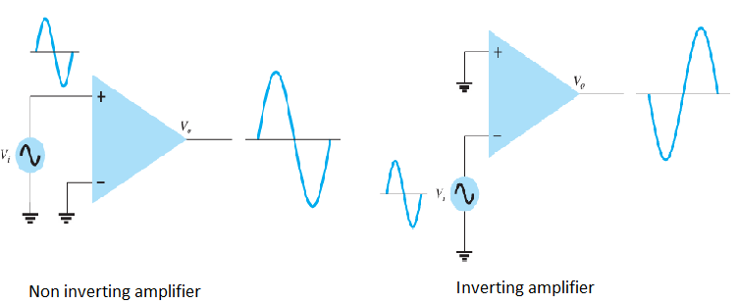
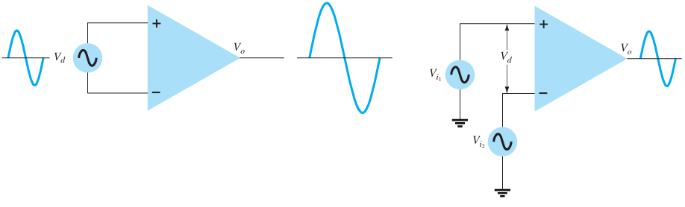
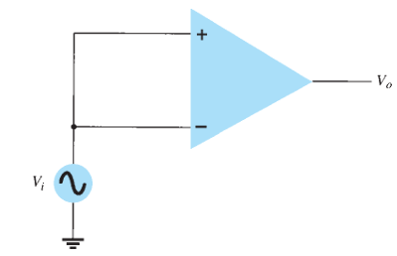
Op-amp Configurations
Open loop (no feedback)
Closed loop (with feedback):
Single ended input
Double ended (Differential) input
Common mode operation
Inverting
Non inverting
Open loop (no feedback)
Double ended (Differential) input
Common mode operation
Fig 3.3 Open loop congigurations

Slide 13
Ideal Characteristics of an Op-amp/Characteristics of an ideal op-amp
Voltage gain (open loop) = ∞ (practical value around 200000).
Input impedance= ∞ (practical value 10¹² ohms)
(zero input current).
Output impedance = 0 (practical value few ohms to several tens of ohms).
Frequency Bandwidth=∞ (Practical value 1 MHZ).
Common mode rejection ratio(CMRR)=∞ (Practical value 80Db).
Slew rate= ∞ (practical value few V/µS.
Offset voltage=0 (practical value few Mv).
Power supply rejection ratio=0.
CMRR, Slew- rate and Offset voltage:
CMRR (Common mode rejection ratio): It is an ability of an op-amp to reject common mode input or noise. CMRR= A_{d}/A_{C}
CMRR(Db)=20log (A_{d}/A_{c})
Slew rate: The maximum rate of change of output voltage of an op-amp with respect to time is called slew rate. Unit of slew rate is V/µS.
Offset Voltage: It is the differential input voltage that would have to be applied to force the op-amp’s output to zero volts.

Slide 14
(What is an IC-555 chip and why is it important in electronics?/Need)
The basic 555 timer gets its name from the fact that there are three internally connected 5kΩ resistors which it uses to generate the two comparators reference voltages. The 555 timer IC is a very cheap, popular and useful precision timing device which can act as either a simple timer to generate single pulses or long-time delays.
The 555 timer IC is an integral part of electronics especially projects, be it a simple project involving a single 8-bit Micro-controller and some peripherals or a complex one involving system on chips (SoCs), its working is involved.
It was introduced in 1971 by the American company Signetics in the original bipolar and low-power CMOS types. The widespread use of this timer is due to its low price, ease of use and stability.

Slide 15
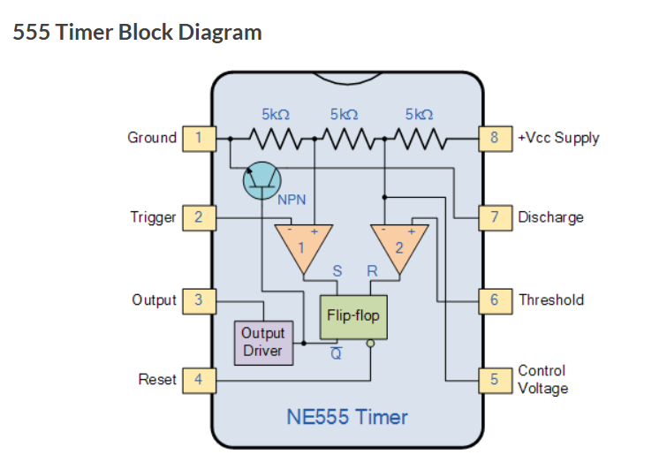
• Pin 1. – Ground, The ground pin connects the 555 timer to the negative (0v) supply rail.
• Pin 2. – Trigger, The negative input to comparator No 1. A negative pulse on this pin “sets” the internal Flip-flop when the voltage drops below 1/3Vcc causing the output to switch from a “LOW” to a “HIGH” state.
• Pin 3. – Output, The output pin can drive any TTL circuit and is capable of sourcing or sinking up to 200mA of current at an output voltage equal to approximately Vcc – 1.5V so small speakers, LEDs or motors can be connected directly to the output.
• Pin 4. – Reset, This pin is used to “reset” the internal Flip-flop controlling the state of the output, pin 3. This is an active-low input and is generally connected to a logic “1” level when not used to prevent any unwanted resetting of the output.
• Pin 5. – Control Voltage, This pin controls the timing of the 555 by overriding the 2/3Vcc level of the voltage divider network. By applying a voltage to this pin the width of the output signal can be varied independently of the RC timing network. When not used it is connected to ground via a 10nF capacitor to eliminate any noise.
• Pin 6. – Threshold, The positive input to comparator No 2. This pin is used to reset the Flip-flop when the voltage applied to it exceeds 2/3Vcc causing the output to switch from “HIGH” to “LOW” state. This pin connects directly to the RC timing circuit.
• Pin 7. – Discharge, The discharge pin is connected directly to the Collector of an internal NPN transistor which is used to “discharge” the timing capacitor to ground when the output at pin 3 switches “LOW”.
• Pin 8. – Supply +Vcc, This is the power supply pin and for general purpose TTL 555 timers is between 4.5V and 15V.

Slide 16
IC- 555(Timer) has the following operating modes:
Monostable (one-shot) mode
Astable (free-running) mode
Feature | Monostable | Astable
Stable states | 1 | 0
Output behavior | Single pulse | Continuous oscillation
Trigger needed? | Yes | No
Uses | Timing delay, pulse generation | Clocks, blinkers, square waves

Slide 17
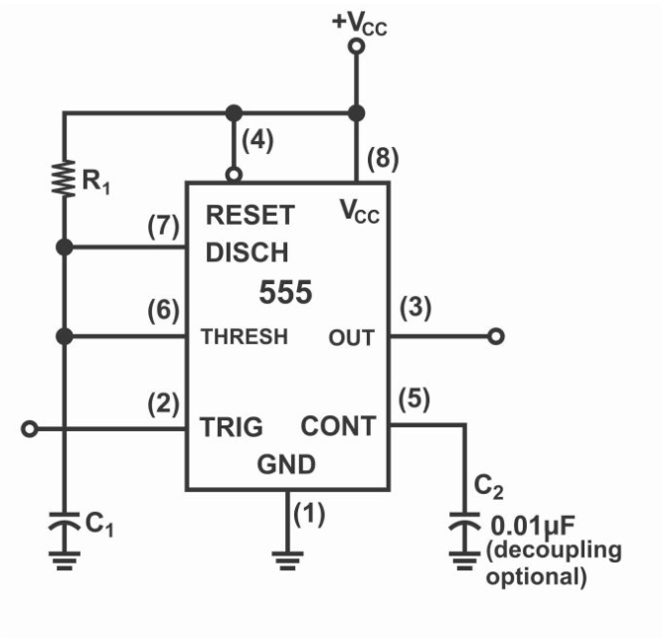
Monostable Multivibrator
This circuit encased in an IC, is just analogous to a basic 555 timer circuit, with the only exception that in monostable circuit, two capacitors and a resistor do also exist outside IC.
A monostable multivibrator, also known as a one-shot pulse generator, has one stable state and one unstable state.
Operation: It remains in its stable state until an external trigger pulse is applied. The trigger forces the circuit into its unstable state for a specific, predetermined period (determined by an external RC network), after which it automatically returns to its original stable state.
Triggering: Requires an external trigger pulse to initiate each cycle.
Applications: Used in time delay circuits, pulse shaping (converting short pulses into wider ones), and switch debouncing.
Output: Produces a single output pulse of a fixed duration for each input trigger pulse. Astable Multivibrator

Slide 18
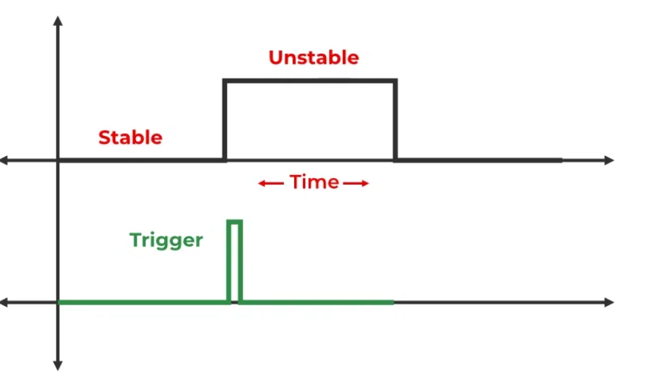
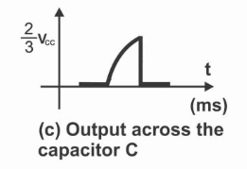
(1). When circuit is energized (normal operating state), then
its output is low
No charge exists on capacitor C₁
Discharge circuit (pin number 7) tends to be closed
(In this stable state, the output is low (logic 0), and an internal transistor keeps the timing capacitor discharged)
(2). When a trigger input pulse is provided, output tends to become high and discharge path is open circuited.
(3). Capacitor C₁ charges till V_{CC} with time constant R₁ C₁
(4). When capacitor voltage reach up to 2/3 V_{CC} (threshold value), then comparator sets output on low and discharge path short circuited again.
(5). As the discharge path is short circuited, capacitor C₁ starts to discharge very speedily.

Slide 19
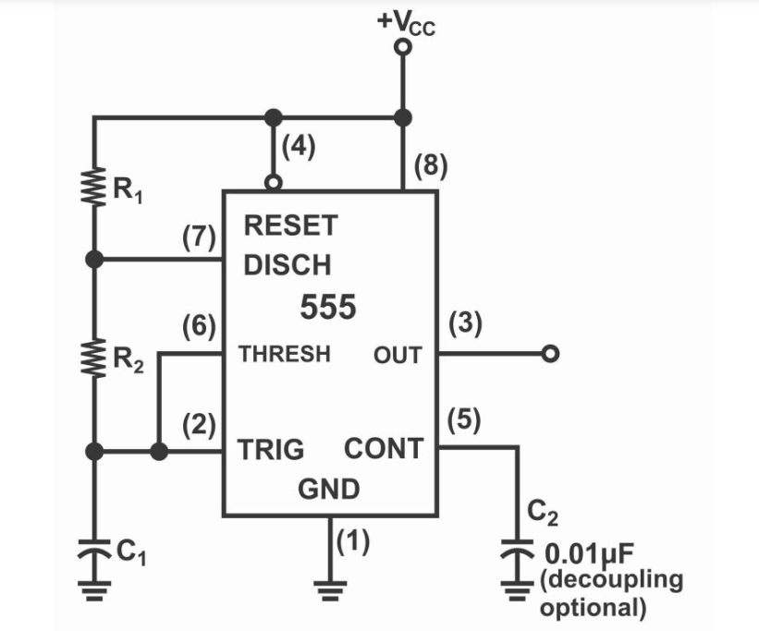
Astable Multivibrator
In this circuit, two resistors R1 and R2 and a capacitor C1 are external components, which form a timing network. A capacitor C2 is also present in this circuit, which has been connected with control voltage.
An astable multivibrator, also called a free-running oscillator, has no stable states and continuously oscillates between two unstable states (high and low voltage) as long as power is supplied.
Operation: It automatically switches back and forth between two states through a positive feedback loop and an RC (resistor-capacitor) timing network that charges and discharges capacitors to control the switching frequency.
Output: Produces a continuous, periodic square wave or pulse train.
Triggering: No external trigger is required for continuous operation.
Applications: Used in clock generators for microprocessors, flashing lights, and general timing oscillator circuits.

Slide 20
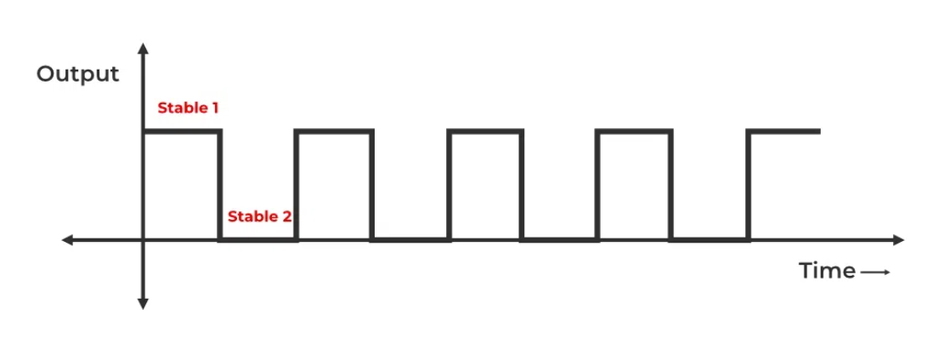
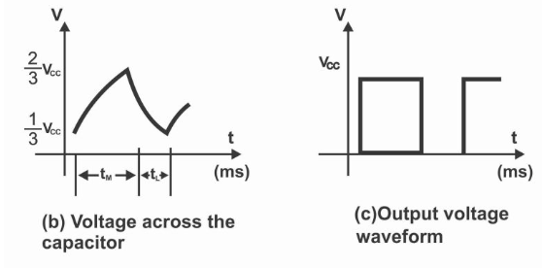
(1). As soon as the circuit is energized, then immediately thereafter;
Voltage level on threshold and input terminal turns out to be low (as compared to 2/3 level of V_{CC})
Output is high
Discharge path (pin number 7) is open circuited
Capacitor C₁ starts charging with time constant (R₁ + R₂) C₁ till V_{CC}.
(2). When voltage value parallel to capacitor C₁, which is also connected to threshold terminal reaches 2/3 V_{CC} , then comparator sets output on low and the discharge path tends to close.
(3). As a result of closure of discharge path, capacitor C₁ discharges very swiftly via R₂, in such a situation, discharge time constant is R₂C₁.
(4). When C₁ capacitor discharges up to 1/3 level of V_{CC}, the comparator circuit tends to push output high, further discharge path also opens.
(5). C tends to re-charge via (R₁ + R2) C₁ time constant up to V_{CC}
(6). After this, afore-mentioned 2, 3, 4 and 5 steps are repeated alternately until the circuit has been de- energized (i.e. until the circuits’ supply is turned off, above-mentioned factors are repeated continuously)

Slide 22
Overview of Cellular Communication
What are Cellular Networks? Cellular networks are a type of wireless communication system that allows mobile devices, such as smartphones and tablets, to connect and communicate.
The network is divided into smaller geographic areas called "cells," each served by a base station (cell tower). The cells enable efficient use of radio frequencies and support large numbers of users over a wide area.
Cellular Network Architecture
Base Station (Cell Tower): Transmits and receives signals to/from mobile devices within its cell. It serves as the bridge between mobile devices and the core network.
Mobile Device (User Equipment): Includes phones, tablets, and other wireless devices that connect to the network.
Mobile Switching Center (MSC): Manages the routing of voice calls and data, handovers, and coordination with other networks. The central part of the network that handles data routing, call management, and connection to other networks (e.g., the internet).
Home Location Register (HLR) and Visitor Location Register (VLR): Databases that store user information, including location, subscription details, and authentication data.

Slide 23
Emerging Technologies
5G and Beyond
Internet of Things (IoT)
IoT Devices: Growing number of connected devices, leading to smart homes, cities, and industries.
Low-Power Wide-Area Networks (LPWAN): Technologies like LoRaWAN and NB-IoT enable long-range connectivity with low power consumption.
Artificial Intelligence and Machine Learning
AI for Network Management: Optimization and automation of networks for improved efficiency and performance.
Machine Learning in Signal Processing: Enhanced algorithms for noise reduction, signal compression, and error correction.
Research is already underway, focusing on higher frequency bands (terahertz), advanced AI integration, and holographic communications.

Slide 24
Emerging Technologies
Massive MIMO and Beamforming
Massive MIMO: Using a large number of antennas to improve spectral efficiency and capacity.
Beamforming: Directing signals to specific users, enhancing signal quality and reducing interference.
Terahertz Communication
High-Frequency Bands: Utilization of terahertz frequencies for ultra-high-speed data transfer.
Blockchain for Communication Networks
Decentralization: Ensuring secure and transparent transactions and data management.

Slide 25
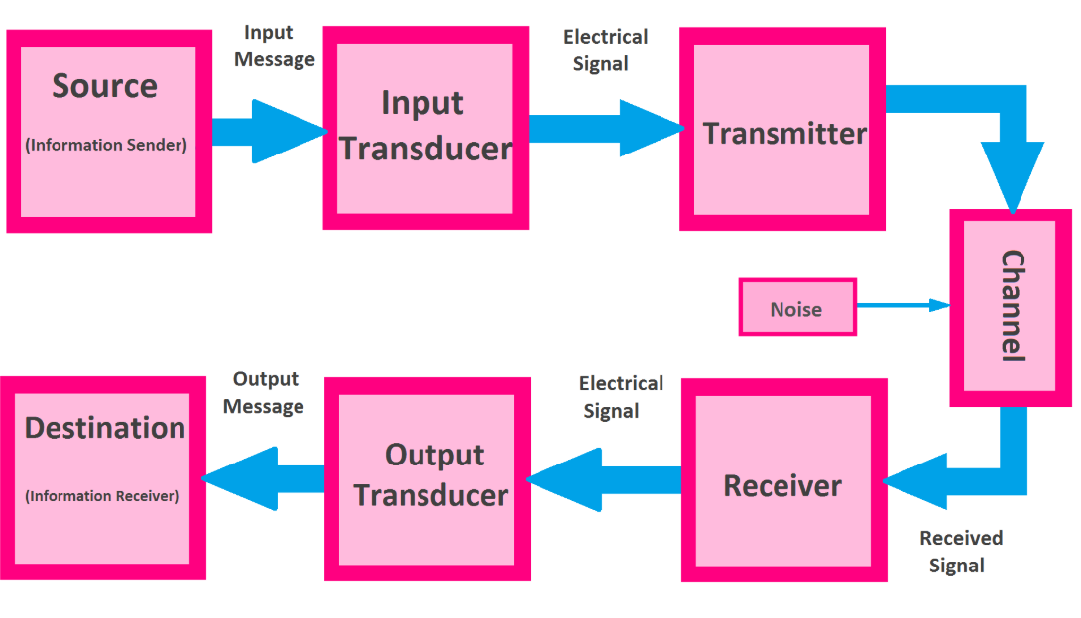
Block Diagram of Communication Systems

Slide 26
Components of a Communication System
Information Source:
The origin of the message or data, which can be analog (voice, video) or digital (text, binary data).
Transmitter:
Modulation: Converts the message signal into a form suitable for transmission. This includes converting the message to an electrical signal and modulating it to fit the transmission medium.
Transmission Medium (Channel):
Wired: Copper cables, fiber optics, and other physical mediums.
Wireless: Radio waves, microwaves, infrared, and other non-physical mediums.
Receiver:
Demodulation: Extracts the original message signal from the received modulated signal to retrieve the original data.
Destination:
End User Device: The destination where the message or data is intended to be received, such as a computer, mobile phone, television, etc.

Slide 27
Example Communication System: Consider a simple radio communication system:
Source: A microphone converts sound (analog signal) into an electrical signal.
Transmitter: The transmitting antenna sends the electrical signal which is modulated onto a carrier frequency.
Transmission Medium: The modulated signal is transmitted through the air as radio waves.
Receiver: An antenna receives the radio waves, and the receiver demodulates the signal to retrieve the original audio.
Destination: The demodulated electrical signal is converted back to sound by a speaker.

Slide 28
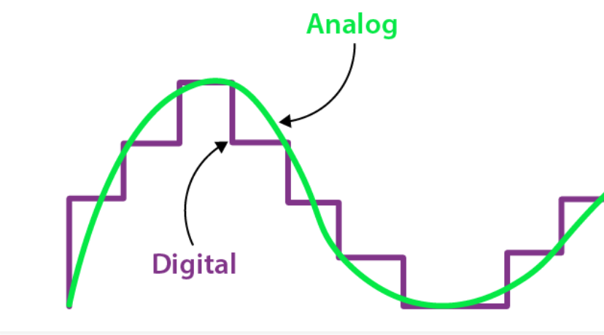
Types of Communication
Analog Communication: Transmits data using continuous signals. Examples include AM and FM radio.
Digital Communication: Transmits data using discrete signals (binary format). Examples include digital telephony, data communication through computers, and modern wireless communication systems like 4G/5G.

Slide 29

What Is Modulation?
Modulation is defined as the process of superimposing a low-frequency signal on a high-frequency carrier signal. The process of varying the RF carrier wave (high frequency signal) in accordance with the information in a low-frequency signal.
Modulation is the process of encoding information in a transmitted signal, while demodulation is the process of extracting information from the transmitted signal.
A device that performs both modulation and demodulation is called a modem -- a name created by combining the first letters of Modulator and Demodulator.

Slide 30
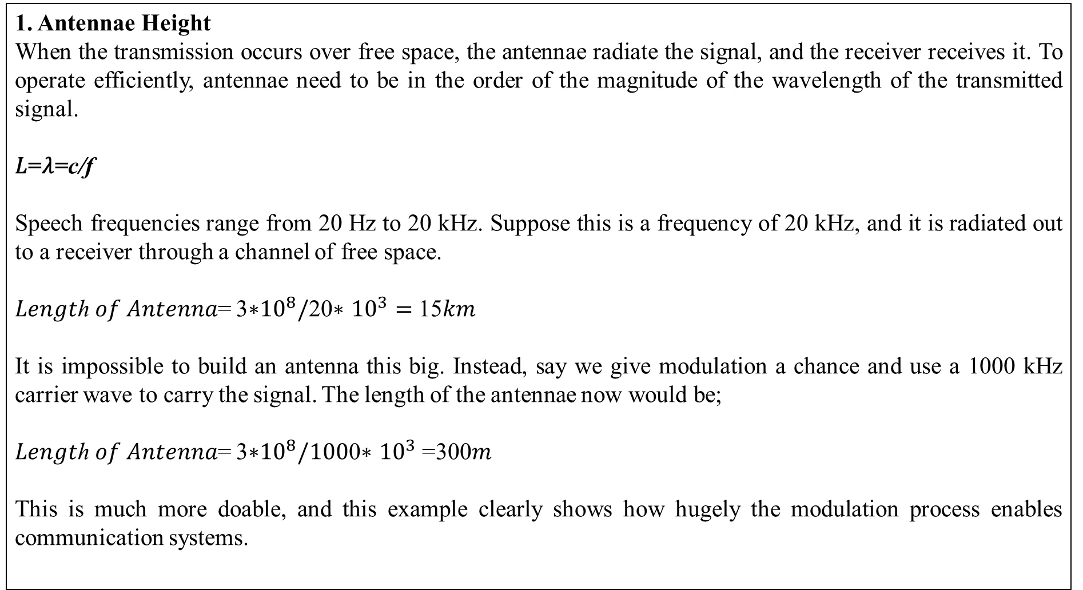
What is the Need for Modulation?
1. Antennae Height
When the transmission occurs over free space, the antennae radiate the signal, and the receiver receives it. To operate efficiently, antennae need to be in the order of the magnitude of the wavelength of the transmitted signal.
𝐿=𝜆=c/f
Speech frequencies range from 20 Hz to 20 kHz. Suppose this is a frequency of 20 kHz, and it is radiated out to a receiver through a channel of free space.
𝐿𝑒𝑛𝑔𝑡ℎ 𝑜𝑓 𝐴𝑛𝑡𝑒𝑛𝑛𝑎= 3∗${10}^{8}/$20∗ ${10}^{3}=$15𝑘𝑚
It is impossible to build an antenna this big. Instead, say we give modulation a chance and use a 1000 kHz carrier wave to carry the signal. The length of the antennae now would be;
𝐿𝑒𝑛𝑔𝑡ℎ 𝑜𝑓 𝐴𝑛𝑡𝑒𝑛𝑛𝑎= 3∗${10}^{8}/100$0∗ ${10}^{3}$=300𝑚
This is much more doable, and this example clearly shows how hugely the modulation process enables communication systems.

Slide 31
What is the Need for Modulation?
2. Interference from Other Signals
By using modulation to transmit the signals through space to long distances, we have removed the need for wires in communication systems. The technique of modulation helped humans to become wireless.
Suppose you transmit the baseband signal to a receiver, say, your friend’s phone. Just like you, there will be thousands of people in the city using their cell phones. There is no way to tell such signals apart, and they will interfere with each other leading to a lot of noise in the system and a very bad output.
By using a carrier wave of high frequencies and allotting a band of frequencies to each message, there is less mixing up of signals, and the received signals are perfect.
We can understand the way we modulate the signals with a simple analogy. Try throwing a piece of paper, it won’t go far. Now, tie it to a stone and throw it again. The second method is obviously more efficient than the first one. This is exactly how we do modulation.

Slide 32
3. Increase the Range of Communication
The frequency of baseband signal is low, and the low frequency signals cannot travel long distance when they are transmitted. They get heavily attenuated. The attenuation reduces with increase in frequency of the transmitted signal, and they travel longer distance. The modulation process increases the frequency of the signal to be transmitted. Therefore, it increases the range of communication.
4. Multiplexing is possible
Multiplexing is a process in which two or more signals can be transmitted over the same communication channel simultaneously. This is possible only with modulation. The multiplexing allows the same channel to be used by many signals. Hence, many TV channels can use the same frequency range, without getting mixed with each other or different frequency signals can be transmitted at the same time.
5. Improves Quality of Reception
With frequency modulation (FM) and the digital communication techniques such as PCM, the effect of noise is reduced to a great extent. This improves quality of reception.

Slide 33
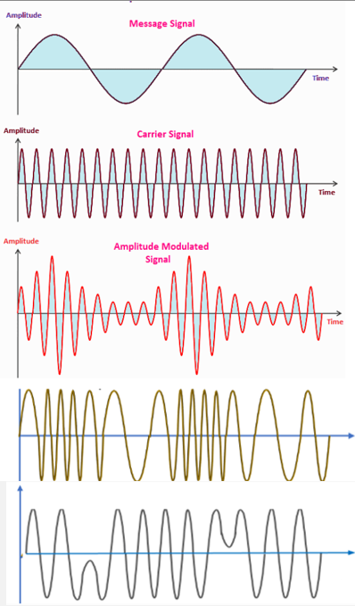
MSG SIGNAL
CARRIER SIGNAL
AM SIGNAL
FM SIGNAL
PM SIGNAL

Slide 34
Different generation of Cellular Communication
1G (First Generation): Analog voice communication. Basic mobile telephony with limited coverage and capacity.
2G (Second Generation): Digital voice communication. Introduced SMS, MMS, and improved voice quality
3G (Third Generation): Enabled mobile data services such as internet browsing and video calling. Higher data speeds.
4G (Fourth Generation): Focus on high-speed data for mobile broadband. Enhanced multimedia, streaming services.
5G (Fifth Generation): Offers ultra-fast data speeds, low latency, and support for massive IoT (Internet of things) connectivity. Enables new applications such as autonomous vehicles, virtual/augmented reality, and smart cities.

Slide 35
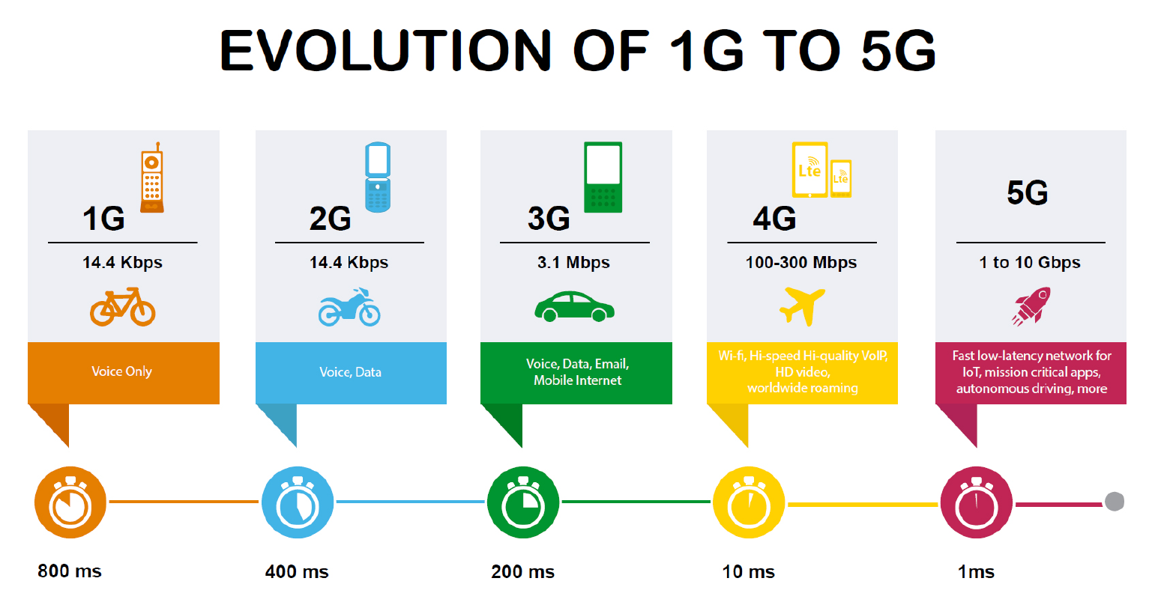

Slide 36
Feature | 5G | 6G
Peak Data Rate | ~10 Gbps | ~1 Tbps
Latency | ~1 ms | ~0.1 ms
Spectrum | Sub-6 GHz, mmWave | Sub-6, mmWave, THz
Network Intelligence | Limited | AI-native
Coverage | Terrestrial | Terrestrial + Satellite
Applications | AR/VR, IoT | Holograms, BCI, digital twins
5G focuses on speed, low latency, and massive IoT.
6G will bring AI-driven, THz-based, ultra-fast networks capable of holography and global coverage.
Both technologies are essential for smart cities, Industry 4.0, healthcare, and future communication systems.

Slide 37
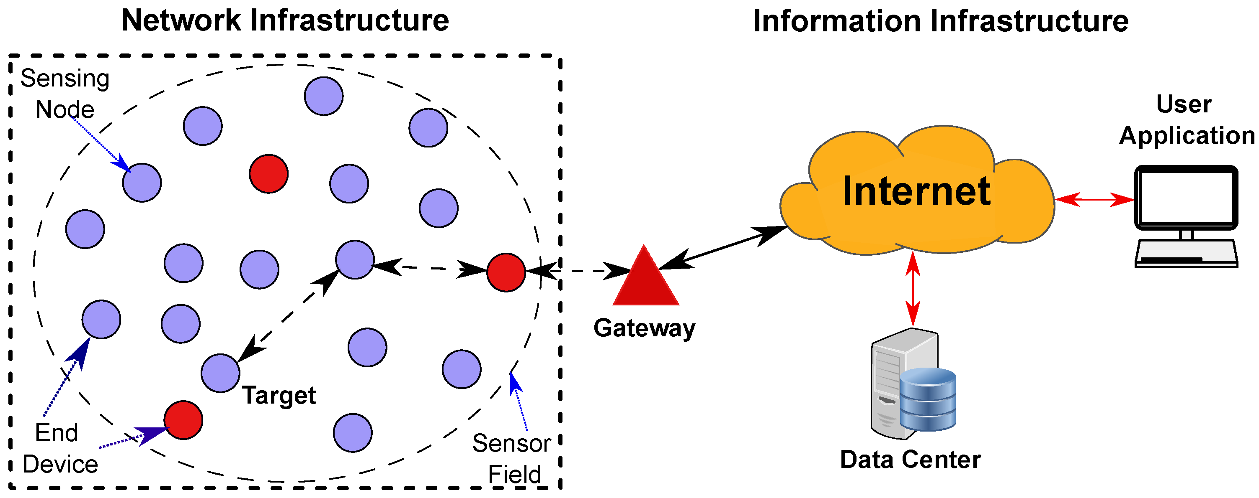
Wireless Sensor Network (WSN), is an infrastructure-less wireless network that is deployed in a large number of wireless sensors in an ad-hoc manner that is used to monitor the system, physical, or environmental conditions.
WSN gathers local environment data via sensor nodes, acting as a subset or foundation for IoT, while IoT (Internet of Things) is the broader ecosystem connecting diverse devices (including WSNs) to the internet for large-scale data exchange, intelligent automation, and cloud-based actions, essentially making data actionable beyond local monitoring.
The key difference: WSNs are about sensing and local communication; IoT is about internet connectivity, device interoperability, and cloud intelligence.

Slide 38
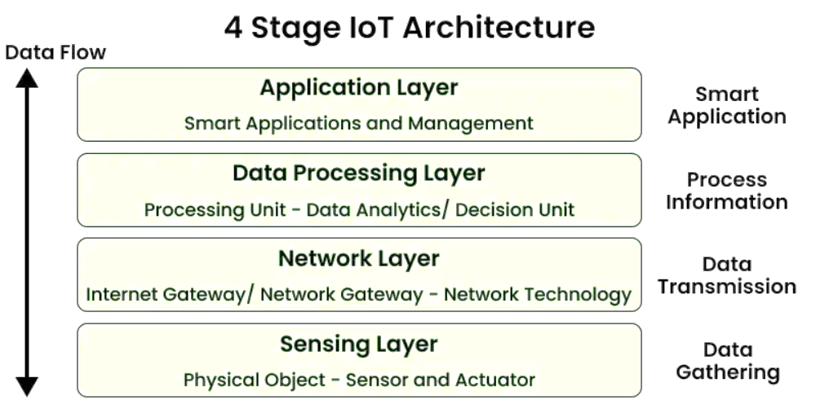
What is IoT Architecture?
IoT architecture refers to the tangle of components such as sensors, actuators, cloud services, Protocols, and layers that make up IoT networking systems. In general, it is divided into layers that allow administrators to evaluate, monitor, and maintain the integrity of the system. The architecture of IoT is a four-step process through which data flows from devices connected to sensors, through a network, and then through the cloud for processing, analysis, and storage. With further development, the Internet of Things is poised to grow even further, providing users with new and improved experiences

Slide 39
IoT Architecture
An IoT system typically layers:
Perception Layer/ Sensing layer (Devices): Physical devices (sensors, actuators, smart objects) collecting or acting on data.
Network Layer (Connectivity): Gateways and communication protocols (Wi-Fi, Zigbee, Cellular) connecting devices to the internet.
Data Processing Layer (Cloud/Edge): Servers, cloud platforms, and apps for data storage, analysis, and user interaction.
Application Layer: This top-most layer interacts directly with end users and business systems. Provides interfaces to monitor and control IoT devices remotely. Displays visual analytics through dashboards and charts. Triggers automated actions based on processed insights
Sensors & Transducers
Sensor: A device that detects a physical property (light, temp, motion) and converts it into an electrical signal.
Transducer: A broader term for a device converting energy from one form to another (e.g., sound to electrical, or a sensor itself).
In IoT: They are the "eyes and ears," capturing real-world data (temperature, humidity, pressure, etc.) for the system.

Slide 40
Wireless Sensor Networks (WSN)
Focus: Data collection from the physical environment (temperature, pressure, etc.).
Architecture: Nodes communicate locally (e.g., Zigbee, LoRa) to a gateway, not always directly to the internet.
Scale: Can be smaller, localized networks.
Power: Nodes are often small, battery-powered, requiring energy efficiency.
Role: The sensing layer providing raw data.
Internet of Things (IoT)
Focus: Connecting everyday objects (sensors, appliances, machines) to the internet for data exchange and control.
Architecture: Involves gateways, cloud platforms, and internet protocols (like IPv6) for global access and complex processing.
Scale: A vast, global network of interconnected devices.
Power: Varies; can include mains-powered devices.
Role: The intelligent layer, using WSN data for smart applications, automation, and user interaction.
Analogy: Think of a WSN as the senses (eyes, ears) of a system, collecting information. IoT is the brain and nervous system that takes that sensory input, processes it (often in the cloud), and decides on actions, controlling other connected "body parts".

